Slide 1
Janazah Workshop
Friday, November 6th 2015
23rd Muharram, 1437 H.
At The MCMC

Slide 2
INTRODUCTION
In the name of Allah Most Merciful Most Gracious
All praise is due to Allah; we praise Allah and seek Allah’s help and forgiveness. And we seek refuge in Allah, Most High, from the evils of our own selves. Whomsoever has been guided by Allah, none can misguide him, and whomsoever is misguided, no one can guide him except Allah.
And I bear witness that there is no god worthy of being worshipped except Allah Al Mighty, alone, without partner or associate. I further bear witness that Muhammad (P.B.U.H) is his true worshipper and messenger, may Allah the exalted bestow His peace and blessings upon him.

Slide 3
Allah says O you who believe! Fear Allah as Allah should be feared, and die not except in a state of Islam. (Quran 3:102).
O mankind ! Be grateful to your lord, Who created you from a single soul and from it created its mate, and from them both Allah created many men and women, and fear Allah through Whom you demand your mutual rights and do not cut relations of Kinship. Surely Allah is ever a watcher over you. (Quran 4:1).
O you who believe! Keep your duty to Allah, and speak always the truth. Allah will direct you to do good deeds and will forgive you your sins. And whosoever obeys Allah and His messenger, he verily has got a great success. (Quran 33:70-71).

Slide 4
contents
1) When a Muslim is at the point of death
2) Just after death has been determined
3) Mourning the dead
4) Al-Ghusl (Washing of the body)
5) Al-Kafan (Shrouding)
a) Kafan of a male
b) Kafan of a female
6) Salatul Janazah (Funeral prayer)
7) Following the Janazah
8) Ad-Dafn (The Burial)
9) Al ‘Iddah (waiting period) for widows
10) Condolences
11) Rewards after death
Special cases
1) Miscarried fetus
2) Children
3) Martyr

Slide 5
DEATH
Allah says: Everyone shall taste death. And only on the day of resurrection shall you be paid your wages in full. And whoever is removed away from the fire and admitted to paradise, this person is indeed successful. The life of this world is only the enjoyment of deception. (Qur 3:185),
Every soul shall have the taste of death. (Qur 29:57).
Prophet Muhammad (صلى الله عليه وسلم) said : " Remember the destroyer of pleasures, for not a day passes upon the grave except it says ‘ I am the house of remoteness; I am the house of loneliness; I am the house of soil; I am the house of worms’ " (Tirmidhi).

Slide 6
Allah says: Say The Angel of Death put in charge of you, will duly take your souls, then you shall be brought back to your Lord. (Quran 32:11).
Death involves agony and hardship.
When Prophet Muhammad (صلى الله عليه وسلم) was dying, he put his hands in a large cup of water which was close to him and wipe his face with it, saying: ‘O Allah help me over the hardship and agony of death’ (Tirmidhi).
The following are simple step by step procedures of what should be done when a Muslim dies.

Slide 7
1) WHEN A MUSLIM IS AT THE POINT OF DEATH
Family members of the dying person and his most pious friends should be informed and should be present at his side to help him turn his thoughts to Allah, encourage him very gently to repent, remind him about all the good deeds that he did, about Allah’s mercy, and Allah’s forgiveness so that he may anticipate Allah’s mercy and Allah’s favors.
Allah said: And who despairs of the mercy of his Lord, but those who are misguided. (Quran 15:56).
Prophet Muhammad (صلى الله عليه وسلم) said: " Let no Muslim die except expecting and hoping the best from Allah" (Muslim).

Slide 8
Those who are present should do the following :
They should be kind and patient.
They should never leave him alone.
They should give him hope, not allowing him to collapse out of pain or panic.
They should prompt him very gently every now and then to say the Shahada: "La ilaha illa Allah", in a very kind and sincere manner as these may be his last words.
Abu-Sa’id Al-Khudri reported that Prophet Muhammad (صلى الله عليه وسلم) said : " Help Muslims who are dying to say: La ilaha illa Allah " (Muslim).
They should make Du’a to Allah to help him go through the pangs of death easily, and forgive him.

Slide 9
NOTE:
There is no authentic proof for reading Surah Yasin beside a dying Muslim.
There is no authentic proof for directing the dying Muslim to the Qiblah.
There is no Islamic teaching for putting the Quran under the head of a dying Muslim.
There is no Islamic teaching of asking those who are junub, or menstruating women, to leave the room.

Slide 10
2) JUST AFTER DEATH HAS BEEN DETERMINED
When the person is confirmed dead, family members or those who are present should:
Close the eyes of the deceased. Umm Salama reported that: When her husband died, Prophet Muhammad (صلى الله عليه وسلم) closed his eyes. (Muslim).
Bind his lower jaw to his head so that it does not sag.
Cover all his body completely with a clean sheet.
Aisha reported: Muslims covered the body of Prophet Muhammad (صلى الله عليه وسلم) when he died" (Bukh & M.)
Make Du’a to Allah to forgive him.
They should hasten to prepare the body for washing, shrouding and burial.

Slide 11
Prophet Muhammad (صلى الله عليه وسلم) said: You should hasten with his burial (Bukhari & Muslim).
They should pay his debts from his money, or if there is not enough, then from any family member or any relative, this matter is important since the Prophet Muhammad (صلى الله عليه وسلم) encouraged Muslims to pay the debts of the deceased.

Slide 12
MOURNING THE DEAD
Mourning the dead is allowed in Islam, but there is a great difference between what is allowed Islamically and the practice of some Muslims at the present time.
Grief at the death of a beloved person is normal, and weeping for the dead is allowed in Islam. What is prohibited is to express grief by wailing (mourning in a loud voice), shrieking, beating the chest and cheeks, tearing hair or clothes, breaking things or scratching faces or saying phrases that makes a Muslim lose faith.
All of this is totally prohibited, and the deceased may feel pain by these actions, Prophet Muhammad (صلى الله عليه وسلم) said: "The deceased suffers when someone wails loudly" (Bukhari & Muslim).

Slide 13
He (صلى الله عليه وسلم) said: Two things in people are Kufr, to ridicule someone on his family genealogy, and to bewail the dead . (Muslim).
He(صلى الله عليه وسلم) also said : " I detest a woman who cries out very loudly, or shaves her hair, or tears her clothes when a beloved one dies " (Bukh & Muslim).
He(صلى الله عليه وسلم) said :" He is not of us who beats his face, tears his clothes and wails loudly when misfortune happens to him as was done before during the days of ignorance " (Bukhari & Muslim).

Slide 14
There is no objection to quiet weeping as Prophet Muhammad (صلى الله عليه وسلم) did when his son died and said: It is a mercy that Allah made in the hearts of his servants" (Bukhari).
Relatives of a deceased Muslim may mourn him for three days only, but a widow mourns her husband four months and ten days.
Prophet Muhammad (صلى الله عليه وسلم) said: It is prohibited for a woman who believes in Allah and the day of judgment to mourn any dead person more than three days except her husband four months and ten days (Bukhari).

Slide 15
AL-GHUSL - WASHING THE DEAD MUSLIM
When a Muslim dies, it is the responsibility of his family or other Muslims to wash him according to the Islamic rites. 2-3 persons may perform the washing.
The person(s) who may wash the deceased should be Muslim, adult, trustworthy and honest.
He should know the Islamic way of washing the dead and be able to carry out the washing.
He should refrain from commenting on the body of the deceased.
NOTE:
A male is washed by males ONLY.
A female is washed by females ONLY.
A married person may be washed by his/her spouse.
A child may be washed a male or female.

Slide 16
PLACE OF WASHING :
The deceased’s body should be washed in a clean, secluded, and private place where clean water and soap are available. Gloves or pieces of cloth are needed.
The body of the deceased should be washed with water and, if available, lotus leaves, or camphor (to be used in the final wash).
The washing should be done three or five, or any more odd number of times if necessary.

Slide 17
WASHING PROCEDURE
Place the body on a table or platform
Remove his clothes
Cover the Awrah with a sheet of cloth.
The head and the upper body should be raised slightly to insure that the water runs from the body down and does not run back to the body.
The Awrah of a male is from the navel to the knee in the presence of males. For a female it is the same in the presence of females.
Start washing by saying:" Bismillah.

Slide 18
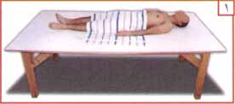

Slide 19
With a piece of cloth or wearing latex gloves, clean away any impurities from the body using water. Dispose of the cloth/gloves.
Using fresh cloth or gloves, press lightly on the stomach of the deceased to expel any remaining impurities, and then wash the body of all impurities.
Then, with fresh cloth or gloves, wash the covered private parts, then dispose of the cloth/gloves.
Then perform Wudu on the deceased without inserting water in the nose or the mouth.
Then clean the body with water and soap (if available), starting from the head (hair, face and beard), then the upper right side of the body then the left side, after that the lower right side then the lower left.

Slide 20
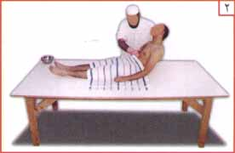

Slide 21
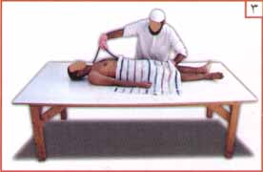

Slide 22
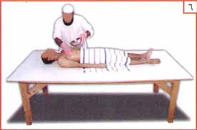
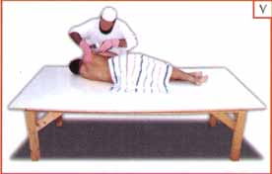

Slide 23
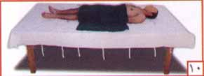

Slide 24
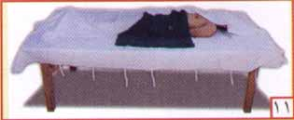

Slide 25
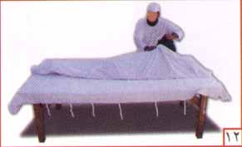

Slide 26
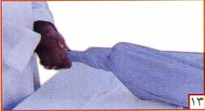

Slide 27
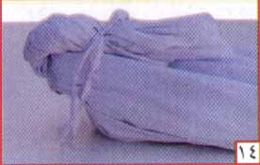

Slide 28
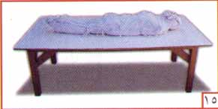

Slide 29
In the case of a female, her hair should be loosened, washed, combed, and be braided in three braids, and placed behind her back.
The washing should be done three, five or seven times, as needed, following the order of head first, then the right side before the left, and the upper parts before the lower ones.
In the last wash, the washer may use camphor, or some perfume with the water.
After that the body should be dried with a clean towel.
Then the body should be totally covered with a white sheet.
Get ready to start the shrouding.

Slide 30
SPECIAL NOTE : In case of a female in her menstrual period or post-natal bleeding, padding should be used to prevent blood from leaving the body.
NOTE:
It is recommended that those who performed the washing should take a bath or make Wudu.
This is all based on the authentic Hadith of Umm Atiyah: When the daughter of the Prophet (صلى الله عليه وسلم) died, he instructed us to “wash her three times, or more, if you feel it is necessary, with water and sidr (good smelling leaves), and then after the last wash apply some camphor to the body , then loosen her hair, wash it, comb it, and make it in three braids laid behind her back " (Bukhari & Muslim).

Slide 31
AL-KAFAN ( SHROUDING)
Shrouding should be done right after the washing. It is recommended to use white sheets from inexpensive material. Extravagance is disapproved of.
Aisha relates that When the Prophet (صلى الله عليه وسلم) died, he was shrouded in three white sheets from Yemen" (Bukhari & Muslim).
THE KAFAN FOR A MALE
It consists of three white winding sheets about 7 x 7 feet, clean and large enough to conceal the whole body, perfumed with incense. It should not be silk nor should any gold be used. Use 4 tie ropes, each 7 feet long.

Slide 32
SHROUDING PROCEDURE
Spread the winding sheets one on the top of the other.
Lift the deceased, his Awrah covered, and lay him on his back on the winding sheets.
Put some scent or perfume on those parts of the body upon which one rests during prostration, that is the forehead, nose, hands, knees, and feet.
Put the deceased’s left hand, if possible, on his chest, then put his right hand on the left hand as in Salah.
Fold the edge of the top sheet over his right side, then the other edge over his left side. Then fold the second sheet in the same way. Then fold the third and largest sheet in the same way.
Fasten the sheets with the tie ropes, one above the head, another under the feet, and two around the body.

Slide 33
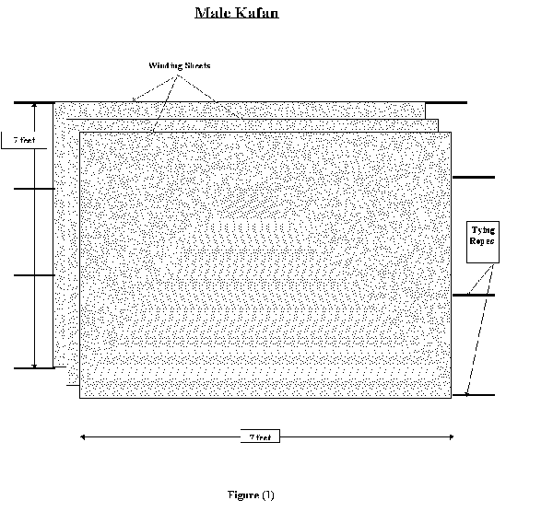

Slide 34
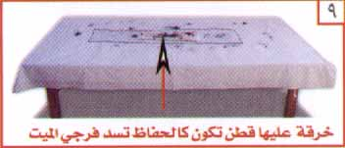

Slide 35
THE KAFAN FOR A FEMALE
The Kafan for a female consists of five white garments, two winding sheets, a long loose sleeveless shirt, from shoulder to feet, a waist wrapper, and a head veil. These should be large enough to cover the whole body and may be perfumed with incense, a loin cloth may be used to bind the upper part of her legs. Use 4 tie ropes, each one 7 feet long.
The approximate measurements are:
the winding sheets (7 x 7 feet),
the long loose sleeveless shirt (3 1/2 x 14 feet, with a hole in the middle line for the head),
the waist wrapper (6 feet x 3 1/2 feet),
the head veil (4x4 square feet white sheet),
and the loin cloth (12 inches wide x 4 feet long).

Slide 36
SHROUDING PROCEDURE
Spread the garments out on top of each other, first the winding sheets, second the long loose sleeveless shirt, with a hole in the middle line for the head, third the waist wrapper, fourth the head veil, and fifth the loin cloth.
Lift the deceased, her Awrah covered, and lay her on her back on the shroud.
Put some scent or perfume on those parts of the body upon which one rests during prostration.
Bind the loin cloth around her upper legs.
Tie the waist wrapper around the waist.
Put the sleeveless shirt and the head veil on her.
Place her left hand on her chest, then her right hand on the left as in the Salah.

Slide 37
Fold the edge of the top sheet over her right side, then the other edge over her left side.
Then fold the second sheet in the same way.
Fasten them with tie ropes, one above the head, another under the feet, and two around the body.

Slide 38
